Slide 1

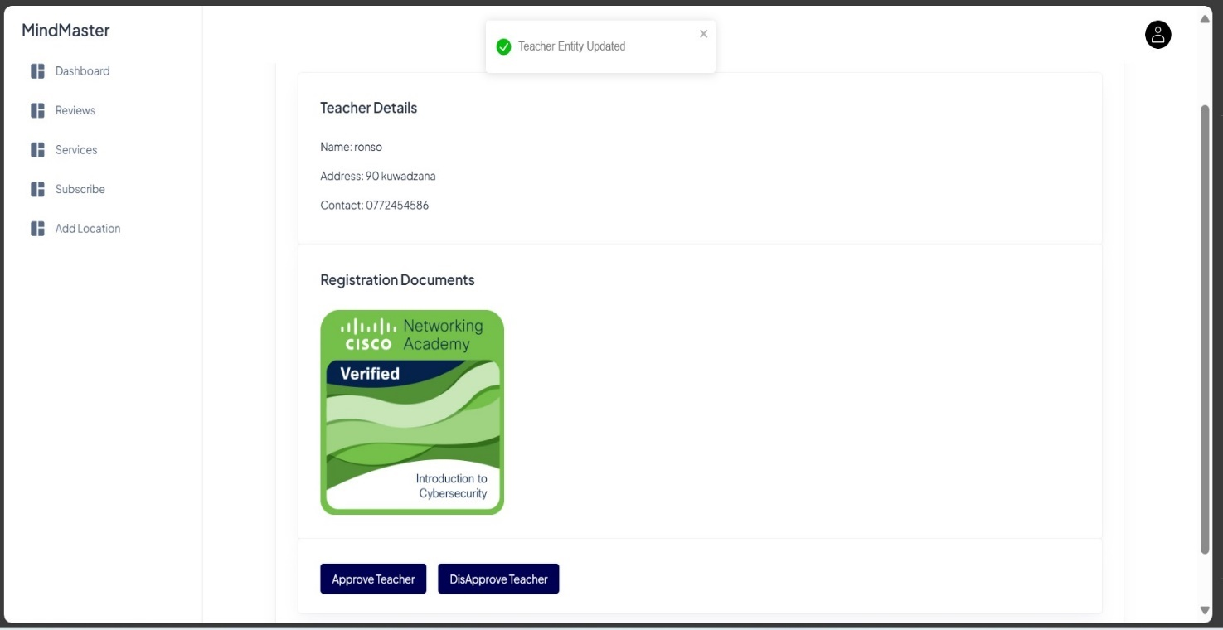
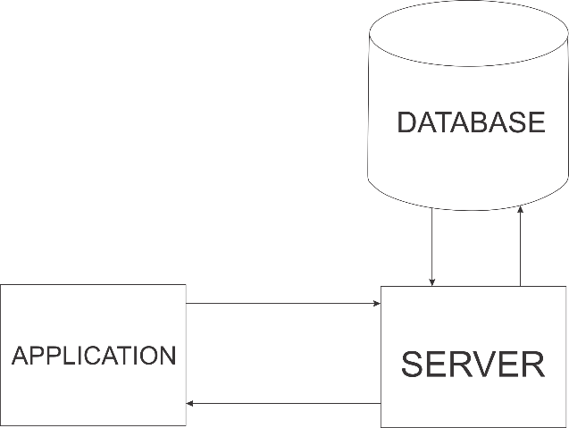
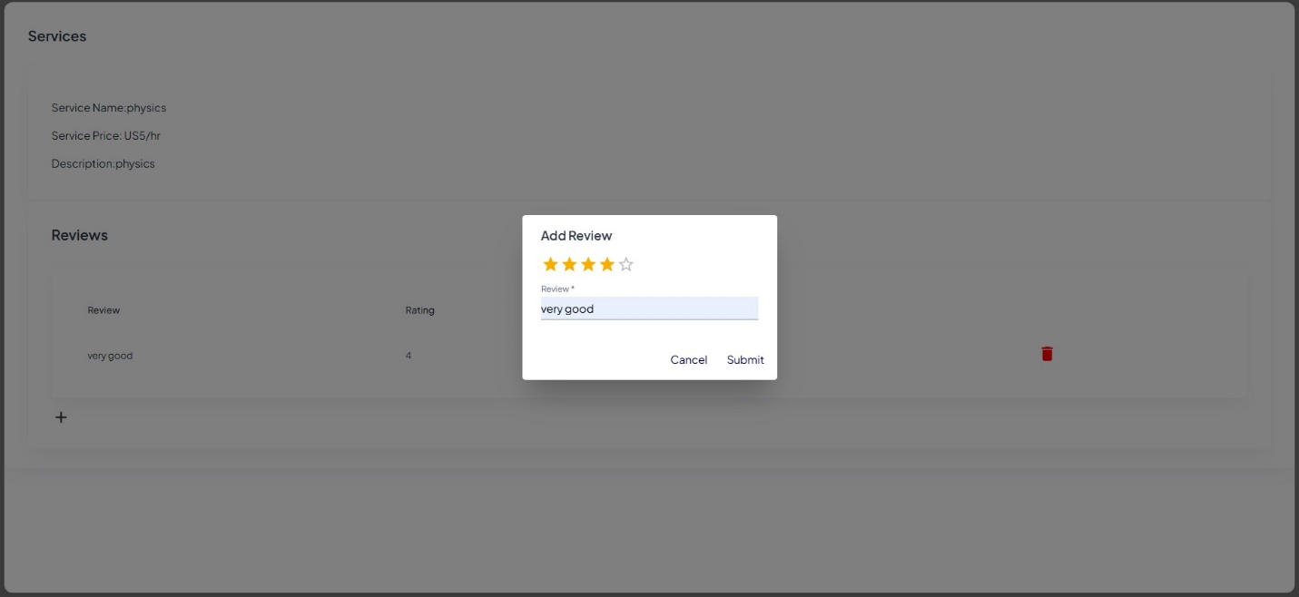
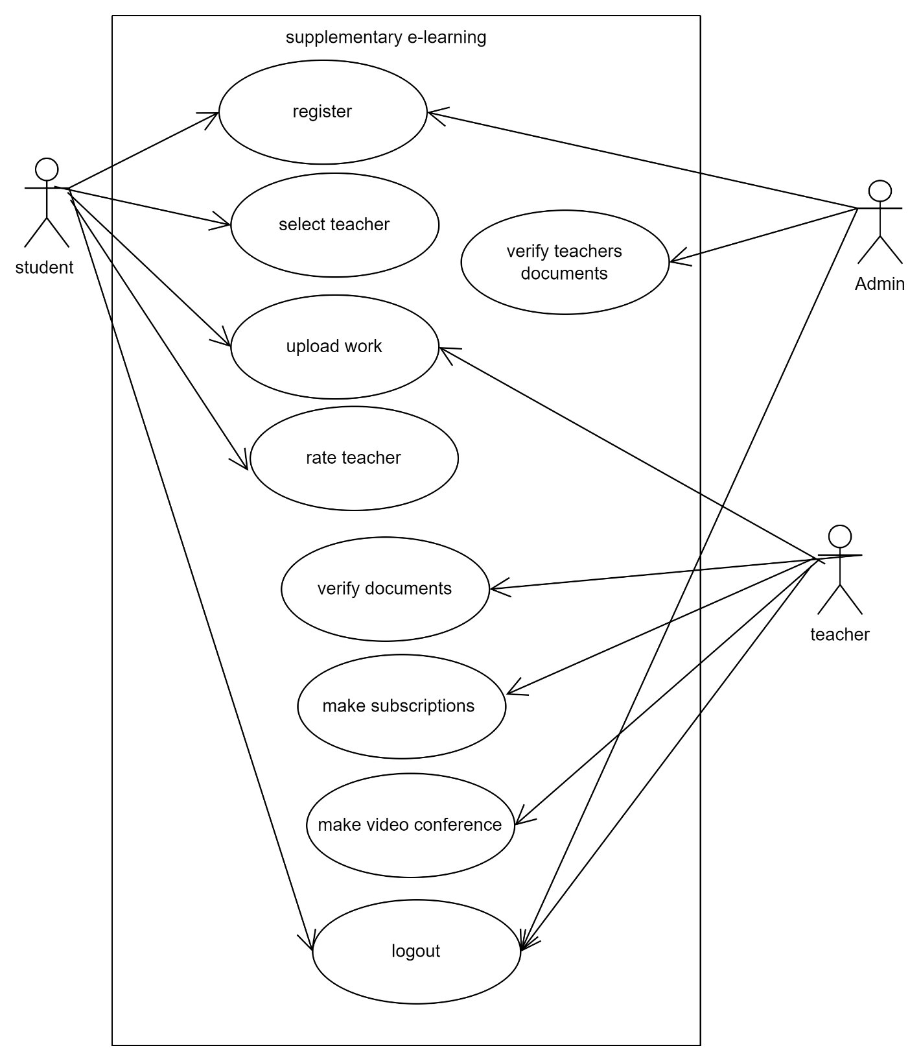
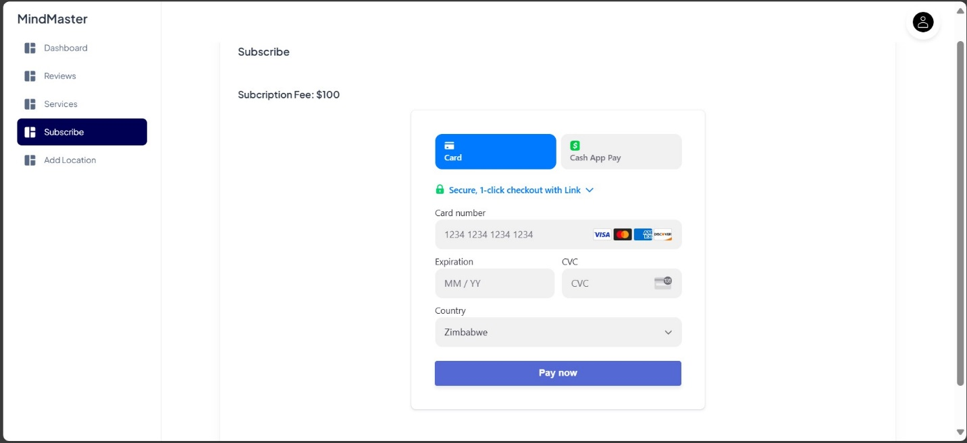
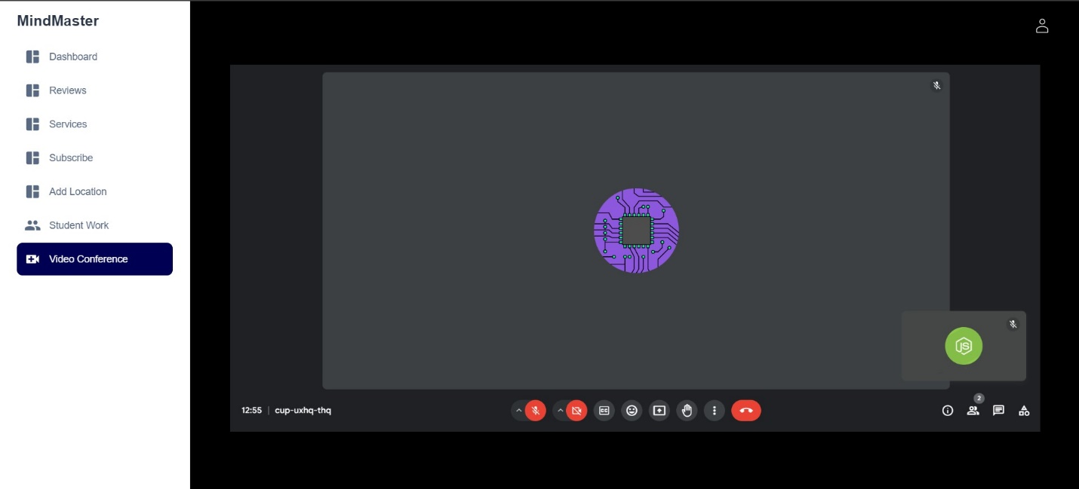
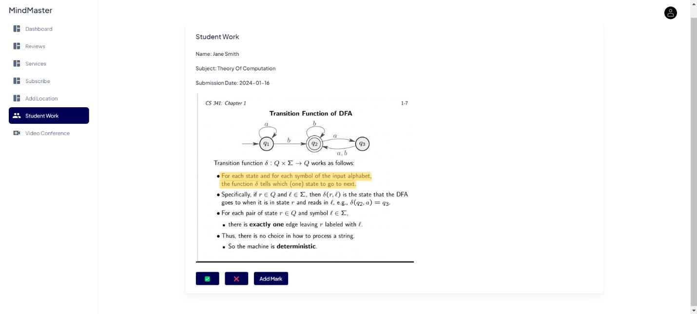
E-learning for Supplementary Education
Thulani Mpofu - Software Engineering Department
1.0 Abstract
3.0. Problem definition
6.0. System Overview
In Zimbabwe extra lessons are conducted physicals in most parts of the country. This paper presents the design and development of an innovative e-learning system tailored to support students who are underperforming in their academic subjects. The proposed web platform facilitates interactions between students and teachers through a range of features, including document verification by the admin, subscription management for teachers, and performance ratings by students. Verified teachers can subscribe to offer their services, upload educational materials, and schedule video conferences with students. Students can search for teachers, request video conferences, and rate their experiences to ensure quality.
Students in Zimbabwe who are underperforming academically often lack the resources and support needed to improve their performance. The existing education system does not provide sufficient mechanisms for personalized tutoring and supplementary learning outside the classroom. This leads to a widening educational gap, with many students failing to reach their full potential.
4.0. Overview of the developed application
The E-Learning System for supplementary education in Zimbabwe is a cutting-edge web platform designed to address the educational needs of students seeking additional academic support. This system aims to provide an accessible, efficient, and interactive learning environment by connecting students with verified teachers who can offer personalized tutoring and a wealth of educational resources. By leveraging modern technology and a user-friendly interface, the system aspires to enhance the overall learning experience and improve academic outcomes for students across the country.
7.0. Use Case Diagram
2.0. Introduction
In recent years, the Zimbabwe economy has not been doing well causing people to do or look for side hustles so that they can ends meet. As for teachers, there has been a growth for supplementary education or extra lessons so that they can earn a few extra cash in their pockets. Furthermore, many students are seeking additional support outside of traditional classrooms settings to enhance their learning and improve their academic performance. Students must travel or sometimes go to their teachers’ houses to conduct those extra lessons; this is due to teachers not having their own infrastructure to teach. Doing lessons in your teacher’s household might not be comfortable for students. Implementing a solution that connects students with the best teachers from all over the country, allowing them to access high-quality education from the comfort of their homes through an online e-learning platform that provides supplementary education.
5.0. Objectives
To create a web application which will allow students to connect with teachers across the country.
To verify teachers’ documents
To allow teachers to make subscriptions.
To allow teachers to set profile
To allow students to rate teachers’ performance.
To allow teachers to start video conferences.
8.0. Screenshots
Conclusion
The E-Learning System for Zimbabwe is dedicated to transforming the educational landscape by providing a robust platform for students and teachers to connect and thrive. By continuously improving and adapting to the needs of its users, the system aims to foster a supportive, effective, and inclusive educational environment.
Supervisor – Mr. Chiworera

